Slide 1
CS2040S Tutorial 7
Done by Xiao Yan

Slide 2
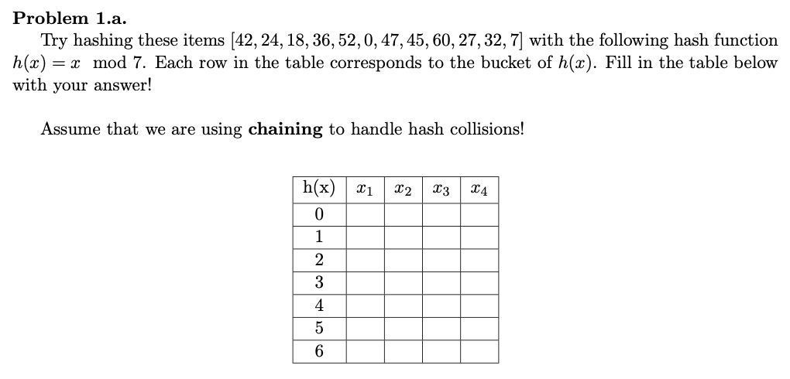
Problem 1.a

Slide 3
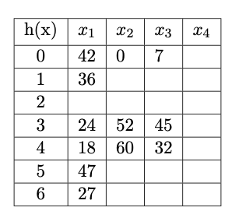
1.a Solution

Slide 4
1.b
We typically use Linked Lists to store the items in a bucket! But... what if instead of a Linked List, we use an AVL Tree to store the items in a bucket?
What are the advantages or disadvantages of such a solution?

Slide 5
1.b Advantage
Worst case time complexity better!
Everything hashed into same bucket.
Insert/look-up:
Linked List: O(n)
AVL Tree: O(logn)

Slide 6
1.b Disadvantages/Overhead
Each node of AVL Tree has to store more information (higher space complexity):
Balance factor
Two child pointers
Linked list only need to store pointer to next node
More complex algorithm: rotations, binary search …

Slide 7
1.b Summary
Improved worst case, but at the cost of more overheads
Good hash function – Uniform hashing assumption:
Expected time identical for Linked List and AVL Tree
Worst case scenario only happens if hash function is not good
Bonus information: Java Hashmap uses Linked List, but will convert it to Red Black Trees (a balanced BST) only when bucket size is large (rare if hash function is good enough)

Slide 8
1.c
The goal of Hash Tables are to store (key, value) pairs. Here’s a question, at each bucket, is storing just the (value) sucient? Or do we need to store the entire (key, value) pair? Why do you think so?
For example, for a (key, value) pair of (17, 200). At the bucket h(17), is storing (200) sucient, or do you need to store (17, 200)?

Slide 9
1.c Solution
NOT sufficient!
(x1, y1) and (x2, y2) s.t. h(x1) = h(x2). Only stores y1, y2 and bucket h(x1).
Search for value of x1:
Encounter bucket h(x1) which has y1 and y2.
No way to tell if y1 or y2 belongs to x1!

Slide 10
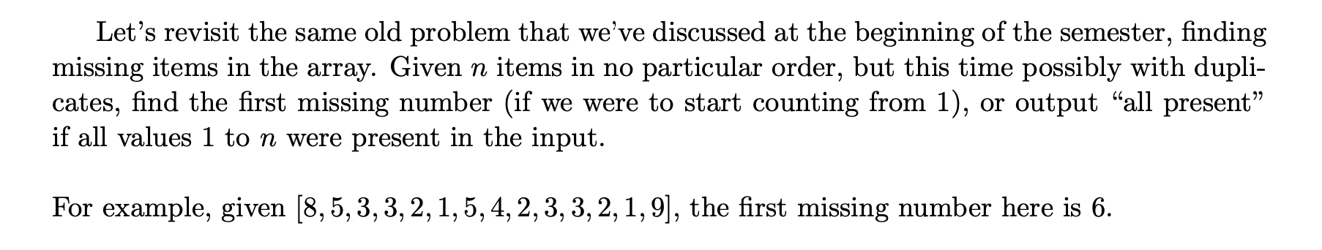
2
N elements with range 1 to n, find first missing number

Slide 11
2
HashSet – add all elements into HashSet and check whether present from 1 to n
boolean [ ] – all initialize to false, change b[i] to true when i is present, find first b[i]==false
O(n) time, O(n) space

Slide 12
2
Bonus: solution using O(1) space?

Slide 13
2
Algorithm is similar to cuckoo hashing (research on it if interested):
Scan from left to right, if we encounter an element A[i]!=i, we check whether A[A[i]] meets the condition of index==value, if so we just throw away A[i], else we put A[i] at A[A[i]] and repeat the process.
After preprocessing, we find the first index that fails the test of A[i]==i

Slide 14
2

Slide 15
2
Idea: place numbers at their own index (for purpose of explanation, assume 1-indexing)
A[1] = 8, so we try to place 8 at A[8] (doesn’t matter what we put at A[1] as replacement)
A[8] = 4, so we set A[8] to 8, then try to place 4 at A[4]
A[4] = 3, so we set A[4] to 4, then try to place 3 at A[3]
A[3] = 3, so we can just discard the value
Continue for A[2], ..., A[size]
Iterate through first n items to find first missing number, then return

Slide 16
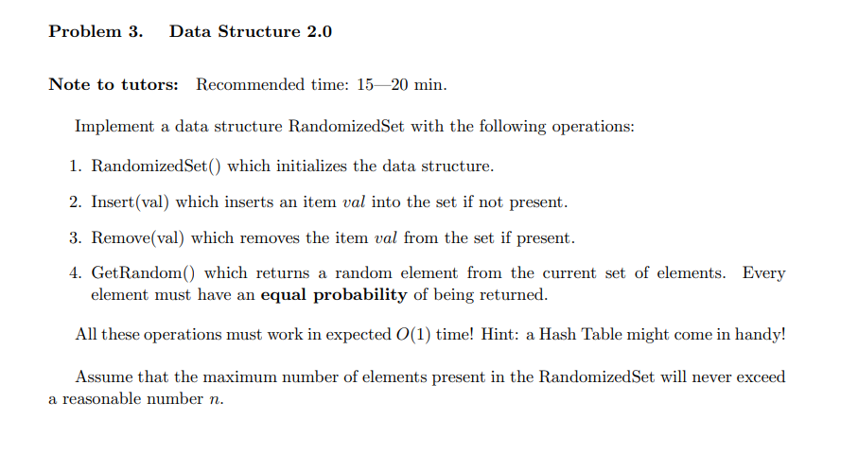
3

Slide 17
3
Combination of Array and Hash Table!!
Array for storing value while Hash Table for storing position
For insertion and deletion, just put new element into the tail of the array or remove the element from the tail of the array.
But think about: how to put the removed element to the tail of the array?
Use Hash Table and swap!!
For GetRandom(), just choose a random integer from [0, size - 1] to be the index

Slide 18
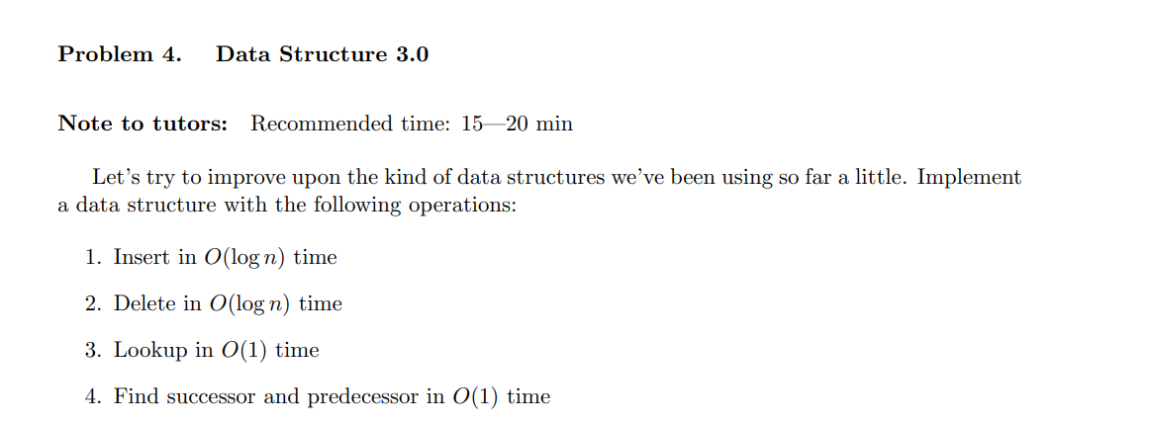
4

Slide 19
4
BST + HashMap
BST: node stores pointers to predecessor and successor Hashmap: stores pointers to node
Insert/Delete: usual operation, insert/delete from map, then update predecessor/successor of node
Lookup: Directly via map Predecessor/Successor: Lookup then traverse via pointer

Slide 20
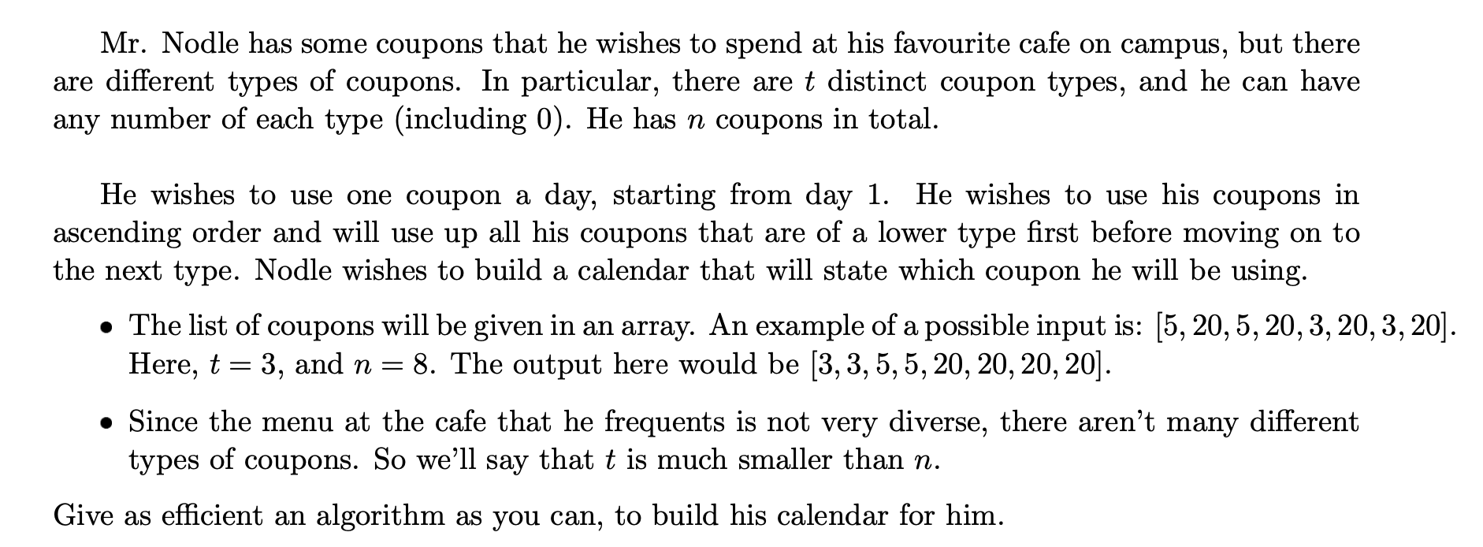
5

Slide 21
5
Given array of n integer with t different possible values
Output the sorted array

Slide 22
5
HashMap + List
If type not in map, insert (type, 1), insert type to list
If type in map, get num of type, insert (type, num + 1)
Sort list
Using list, retrieve num of each type from map, build result array
O(n + tlogt) → O(n) since t << n

Slide 23
5
Alternatives:
BST - storing (value, count) pair in each node
n insertions, max size t → O(nlogt)
3-way partitioning QuickSort
also O(nlogt)

